Slide 1
WEISS Planning Support System
Revised by Randbee Consultants for the WaterInnEU Project

Slide 2
WEISS The Water Emission Inventory planning Support System
Overview
With WEISS you can:
Take an inventory of emission sources to water;
Allocate the emission source spatially;
Analyze sectorial contributions and spatial patterns;
Have a clear idea of the pollutant destiny through the water cycle.

Slide 3
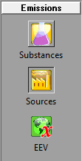
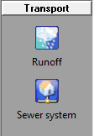
WEISS is built in three different part:
1 – Emissions 2 – Transport 3 - Analyses

Slide 4
Emissions: Substances
All the substances are grouped in classes.
For instance “Metals”.
For each substances you can define the unit you prefer.
You can also add the
CAS number.

Slide 5
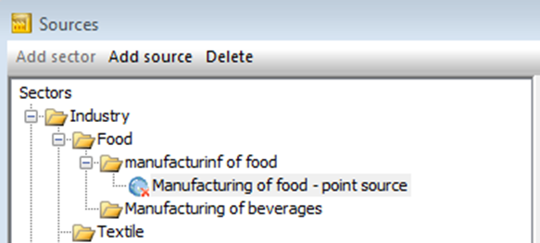
Emissions: Sources
The sources are built in sector
For the sectors and the sources, you can:
- have several sectors vertically;
- have several sectors horizontally;
- have in the same sector a resource and a sector.
The goal is reaching a structure like that

Slide 6
Emissions: EEV, Emission Explanatory Variables
It’s very difficult compute diffuse emissions.
So they’re estimated with this equation:
Gross emission= EF*EEV
Where:
EF is the emission factor expressed in g/m³;
EEV is the emission explanatory variable expressed in m³.
Note:
The algorithm used for the estimation of the EEV could change.
Often a dasymetric mapping algorithm is used, in which a land use map could be the proxy data to allocate the emission source as precisely as possible.

Slide 7
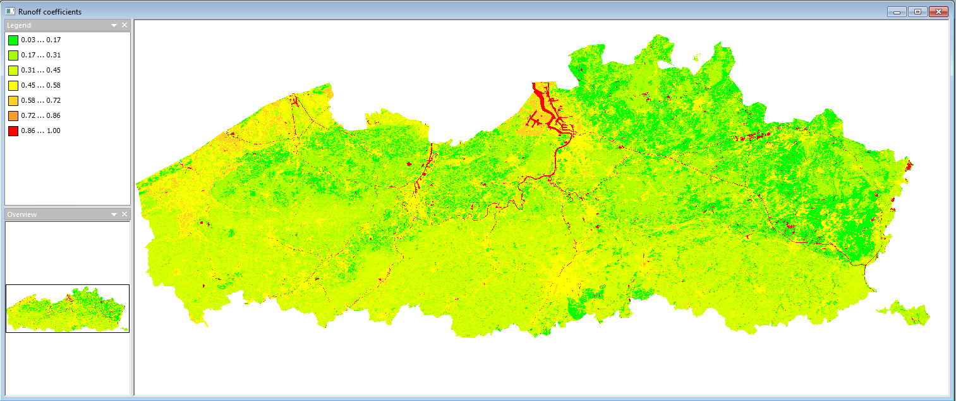
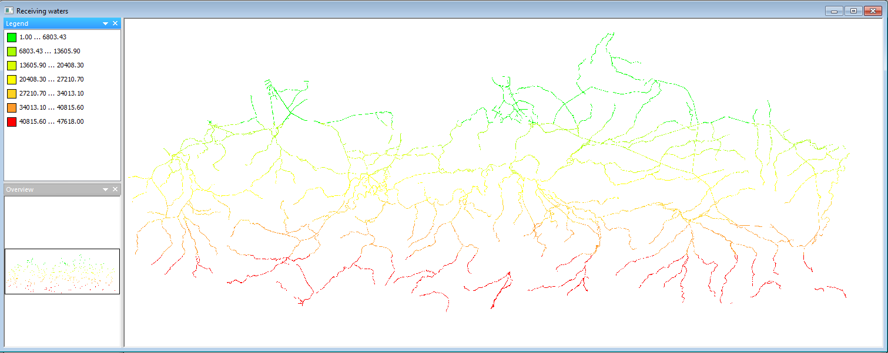
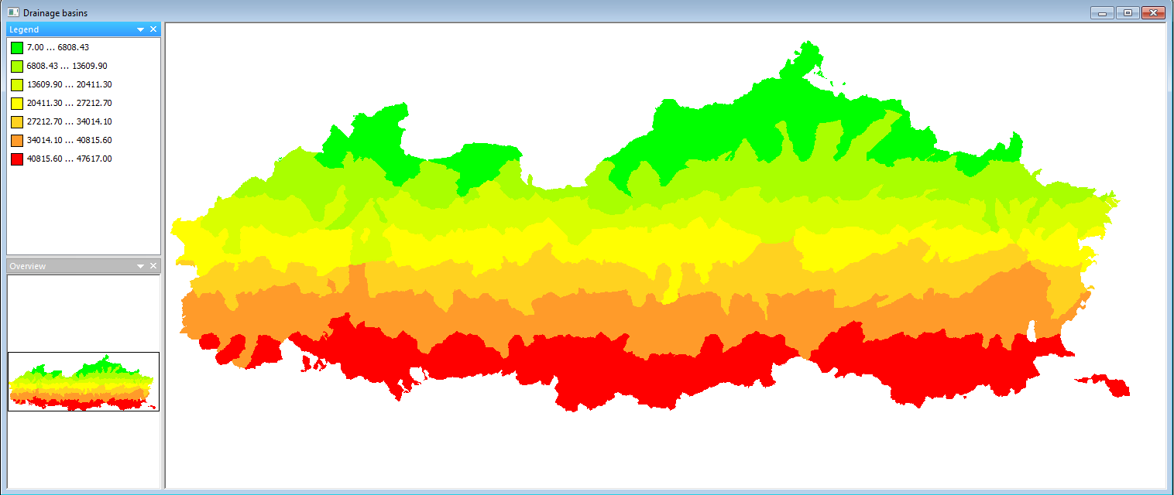
Transport: Run-Off
WEISS allows you to follow the whole path of the substances into the water.
All the calculation are spatially distributed with GIS tools.
The maps for the run-off computation are shown on the left.

Slide 8
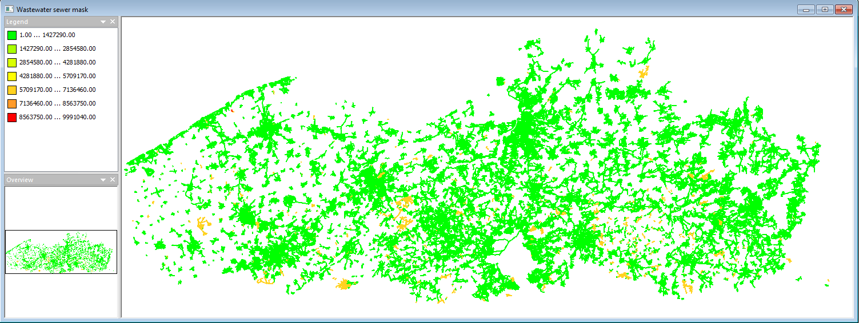
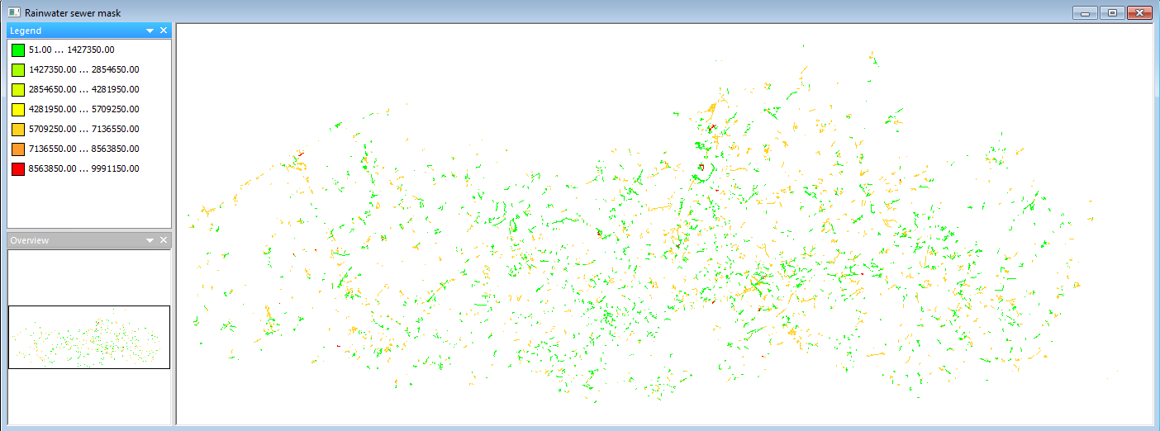
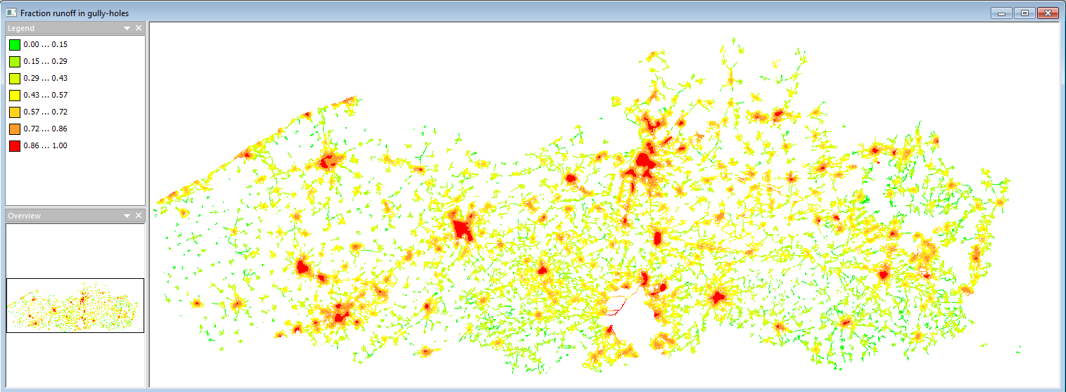
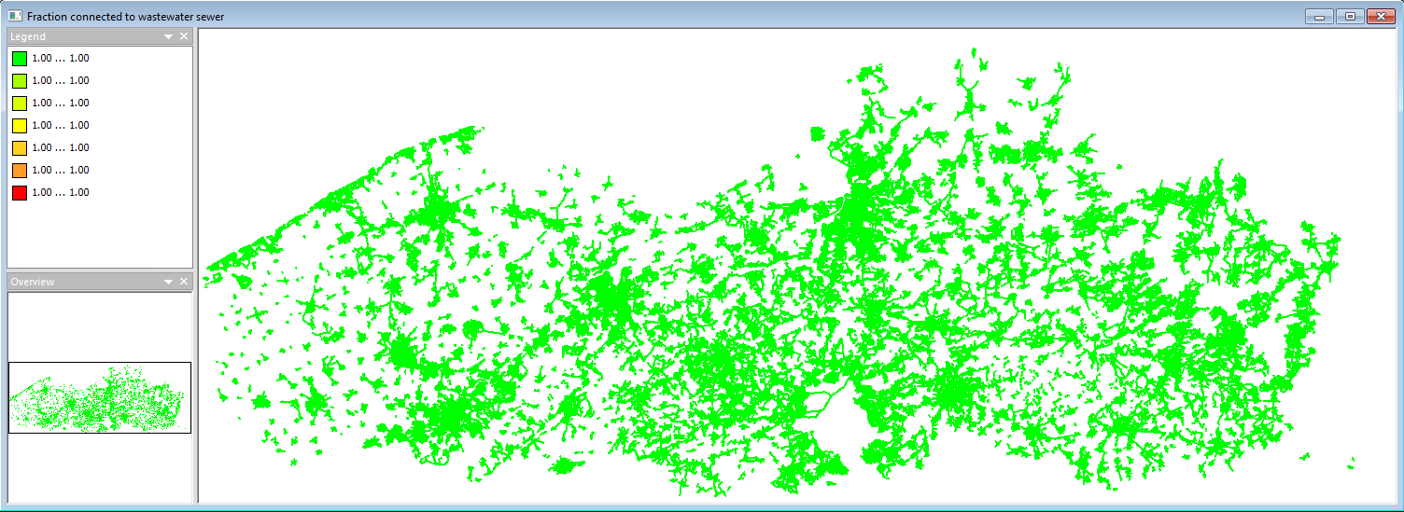
Transport: Sewer system
Some pollutants arrive to the water body through the sewer system.
WEISS has the possibility to implement spatial information about the sewer system’s net like the fraction of land connected to the sewer system, the rain water sewer network and the fraction of run-off that get into the sewer system with the gully-holes.

Slide 9
Analysis
Compute: to carry out the calculations. You must specify substance and source.
Flow chart: to view the emissions in the material flow scheme. You can also consult the maps by clicking on the nodes.
Top 10: to have an insight in the most significant emission sources in a specific region.
Gross/net: to know the ratio between gross emission and a net emission.
Net emissions: to know about the various transport routes to the surface water. You could also choose unit dimension, the data could be displayed on a pie chart.
WWTP: It allows to better understand how much the estimate emission are credible. You can compare the estimated emissions with the evaluated emission on the WWTP.

Slide 10
Analysis: Flow chart, transport to surface water
Pathway from the source to the surface water
27 nodes and 12 positions where the spatial pattern can be queried and visualized via a map.
Blue cell: to visualize the information on the map
Grey cell: substances’ addictions. It can not be visualized on a map
Red cell: substances’ loss to air, soil or groundwater or for a Waste Water Treatment Plants (WWTP)

